Slide 1

NetTower – Network Situational Awareness Tool
Benjamin Molloy
ASE-485 Capstone FP

Slide 2
Problem Domain
“Small or disrupted networks lack a simple way to quickly understand what devices are present and how they are generally connected.”
Limited visibility in small or disrupted networks
No centralized monitoring in home labs / ad-hoc environments
Enterprise tools are complex and resource-heavy
Difficult to quickly identify:
Devices on the network
Reachability
High-level connectivity

Slide 3
Solution
“NetTower provides a lightweight, quickly deployable system that discovers reachable devices, infers high-level connectivity relationships, and presents the results through an intuitive network visualization.”
Lightweight, agentless network discovery system
Identifies reachable devices on a network
Infers high-level connectivity relationships
Presents results through an intuitive topology view
Designed for clarity and accessibility over deep analysis

Slide 4
Solution Overview (Tech Stack)
Languages
Python (Backend)
JavaScript, HTML, CSS (Frontend)
Core Components
Discovery (Active + Passive Scanning)
Event-driven processing pipeline
Data modeling (Hosts & Edges)
MongoDB (runtime storage)
Electron-based visualization interface
Networking Tools
tcpdump
ICMP / ARP utilities
traceroute
nmap

Slide 5
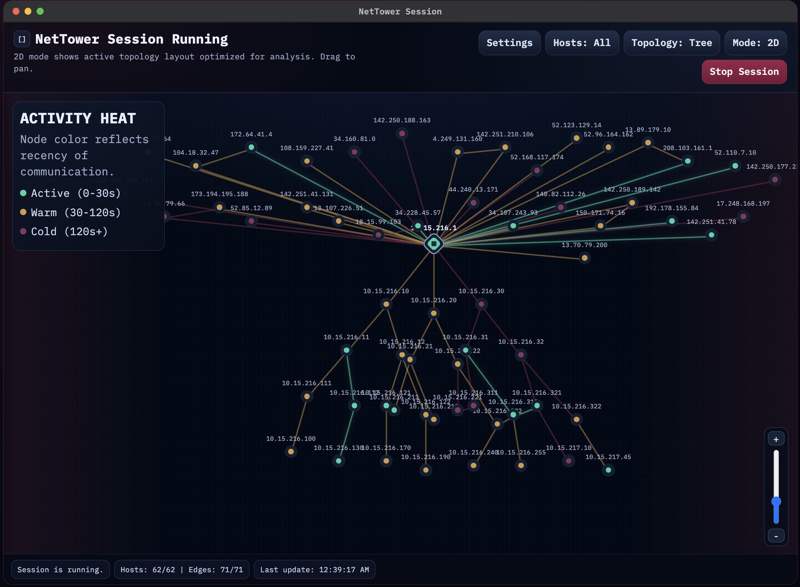
Demo (Video/Product Page)
Demo Vid (OneDrive)
Demo Vid (GitHub)
https://nettower.org
https://molloy.info

Slide 6
Sprint Progress
Canvas: Progress Link
GitHub: Progress Link
Sprint 1 (Backend Development)
Project setup and baseline discovery
Host identification and scanning
Connectivity inference and relationship modeling
Backend pipeline completion and stabilization
Sprint 2 (Frontend + Integration)
Frontend development and visualization
UI refinement and enhancements
Backend–frontend integration
Performance optimization and testing
Documentation and final deployment

Slide 7
AI Use (Coding + Learning)
AI for Development
Assisted with architecture refinement
Helped debug and validate implementation decisions
Accelerated iteration and problem-solving
Learning with AI
Layer 2–4 protocol behavior and limitations
Packet structure (Ethernet, IP, TCP/UDP, ICMP)
Understanding what can vs cannot be inferred from network data
Validating reasoning in constrained environments

Slide 8
Burn Down / Key Numbers
Key Numbers
Total Lines of Code: 18,652
Core Features: 8/8
Requirements: 17/17
100% Burn Down Rate
Code Tests
Automated Tests: 28/28 Passed
Manual Tests: 6/6 Passed
Total Tests: 34/34 Passed

Slide 9
Future Plans
Rework Correlation and Interpretation Model
Modernize UI
Platform Implementation
Host Agent Integration Option

Slide 10
Questions?

